Slide 1
Distracted Driver Detection
Jie Gu (jg6617)
Fan Zhang (fz2068)

Slide 2
Executive Summary

Slide 3
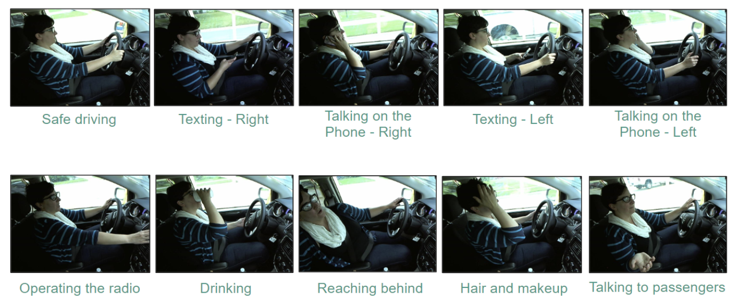
Executive Summary
Goal: accurately classify the status of the driver given the photo.
Approach: used pre-trained networks to help with the prediction.
Value: prevent accidents due to distracted driving.

Slide 4
Problem Motivation

Slide 5

Problem Motivation
The National Highway Traffic Safety Administration (NHTSA) reported that 4410 people died in motor vehicle crashes in 2018 which is due to distracted driving.
Many states now have laws against texting, talking on a cell phone, and other distractions while driving.
Computer vision can help prevent accidents caused by distracted driving by sending a timely alert.

Slide 6
Background Work

Slide 7
Background Work
Blog post on how to do transfer learning using MobileNet:
https://towardsdatascience.com/transfer-learning-using-mobilenet-and-keras-c75daf7ff299
Transfer learning approach:
https://towardsdatascience.com/transfer-learning-from-pre-trained-models-f2393f124751
Extra layers for transfer learning:
https://machinelearningmastery.com/how-to-improve-performance-with-transfer-learning-for-deep-learning-neural-networks/

Slide 8
Technical Challenges

Slide 9
Challenges:
Problem:
Data Leakage
Solution:
Split based on Id
Problem:
Limited training set
Solution:
Transfer learning
Problem:
Low Transferability
Solution:
Finetune & source model selection

Slide 10
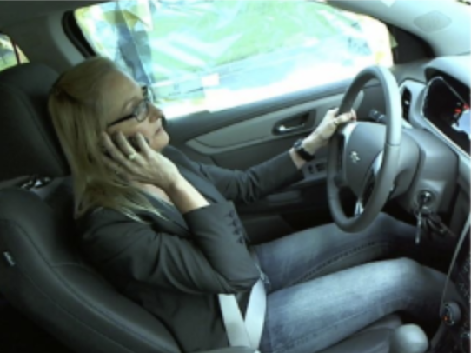
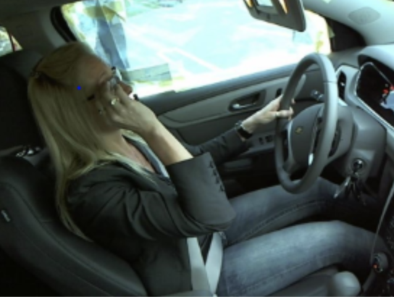
Challenges:
Problem:
Image class confusion
Solution:
Image augmentation
Fig: Sample of image class confusion (i) Taking on the phone (ii) Hair and Makeup

Slide 11
Approaches

Slide 12
Approaches
Determine trainable layers
Choose optimizer
Baseline model:
simple cnn model
Transfer learning
Add extra layers
Find best model
Add image augmentation
Try various
architectures

Slide 13
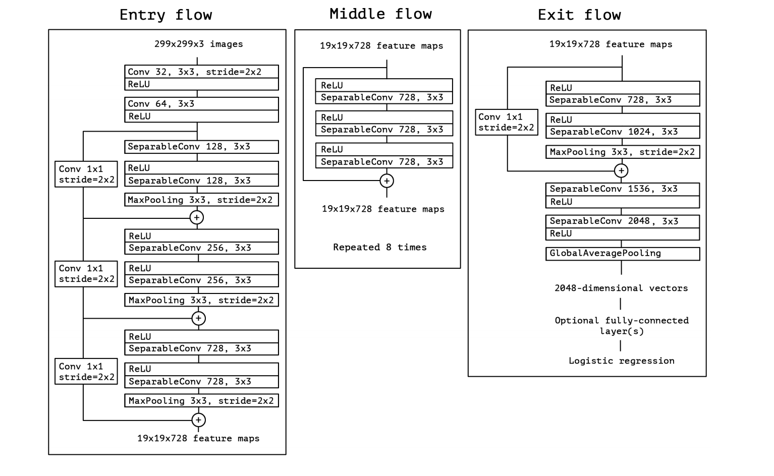
Solution Diagram: Xception
Reference: https://openaccess.thecvf.com/content_cvpr_2017/papers/Chollet_Xception_Deep_Learning_CVPR_2017_paper.pdf

Slide 14
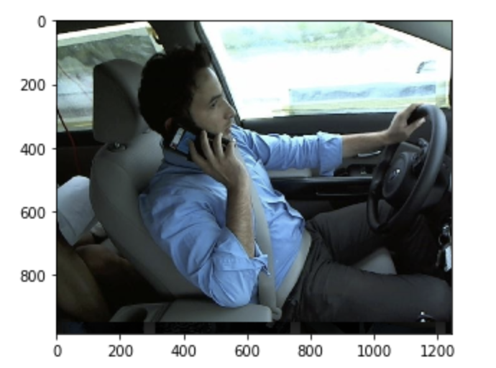
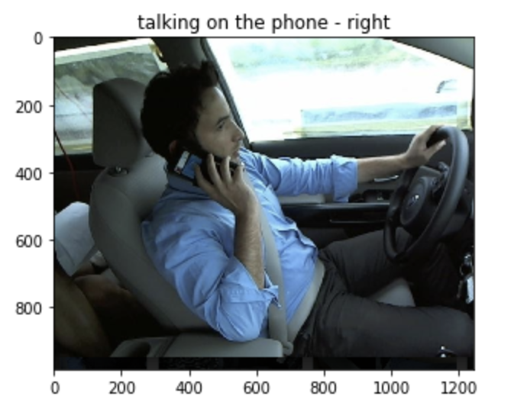
Implementation Details
Training Data:
State Farm Distracted Driver Detection (Kaggle)
Data Augmentation:
(Rotation,Brightness,Cutout)
Pretrained Data:
Imagenet
Transfer Learning: Pretrain
Transfer Learning: Fine Tuning
Model: Xception
GPU: P100
Single Input Example
SIngle Output Example
Save to Cloud

Slide 15
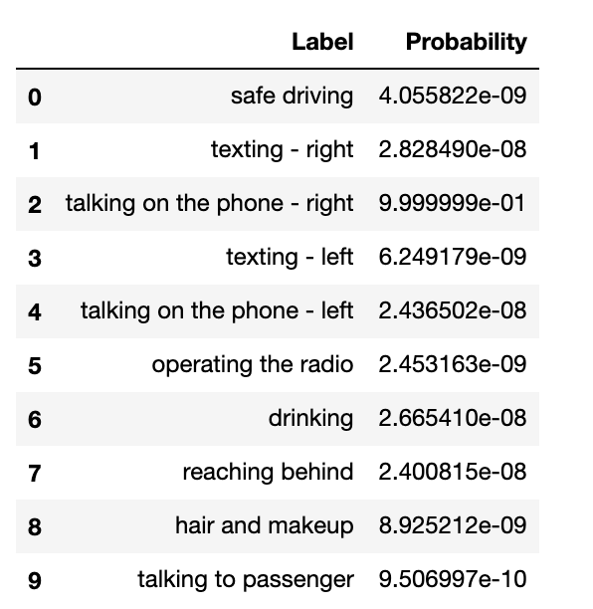
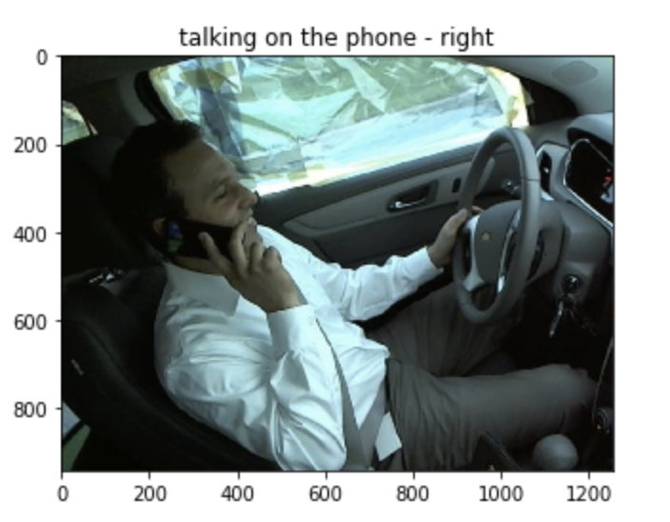
Demo

Slide 16
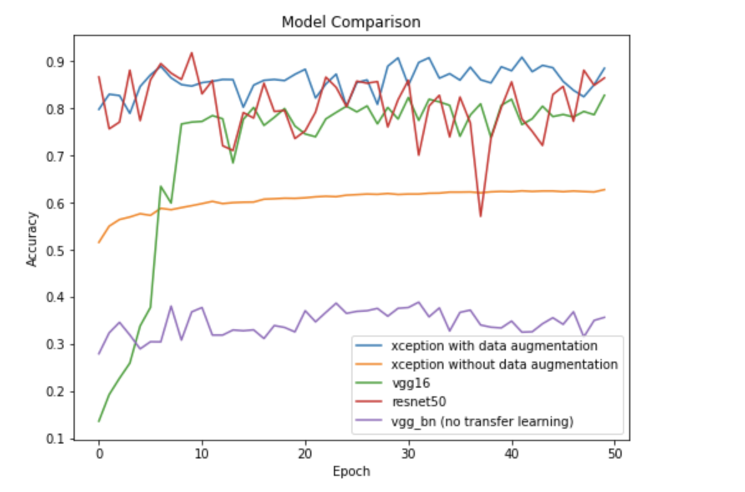
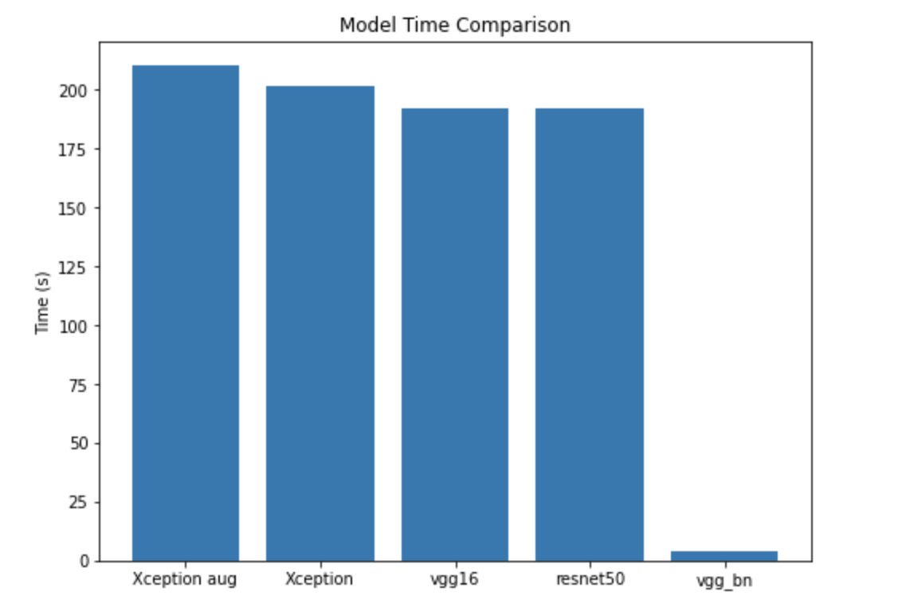
Evaluation: Model Comparison

Slide 17
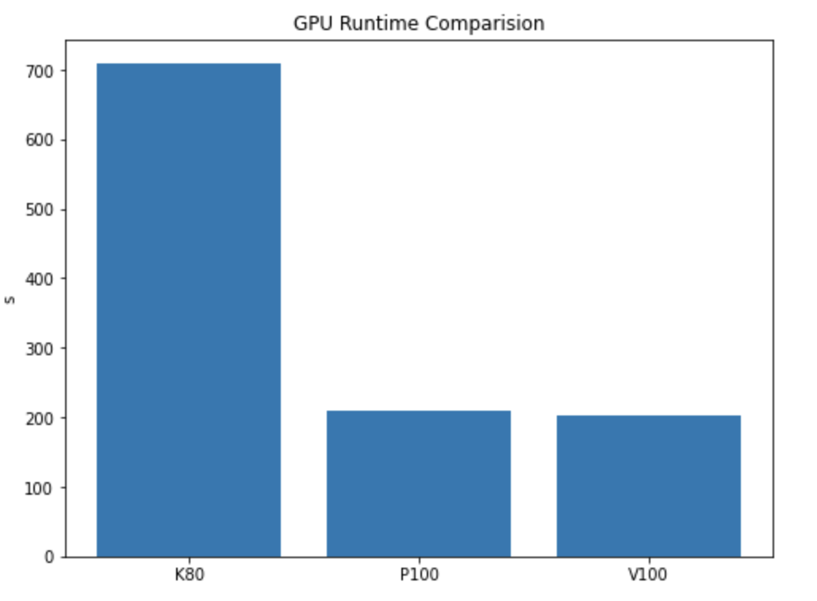
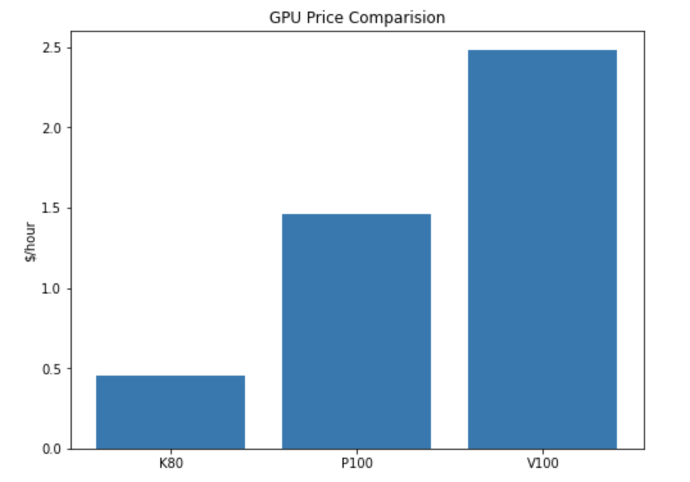
Evaluation: GPU Comparison

Slide 18
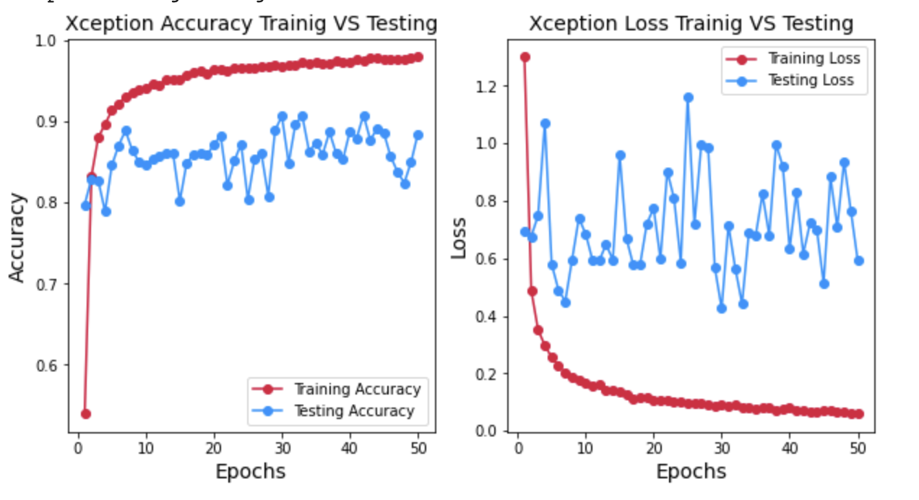
Evaluation: Xception

Slide 19
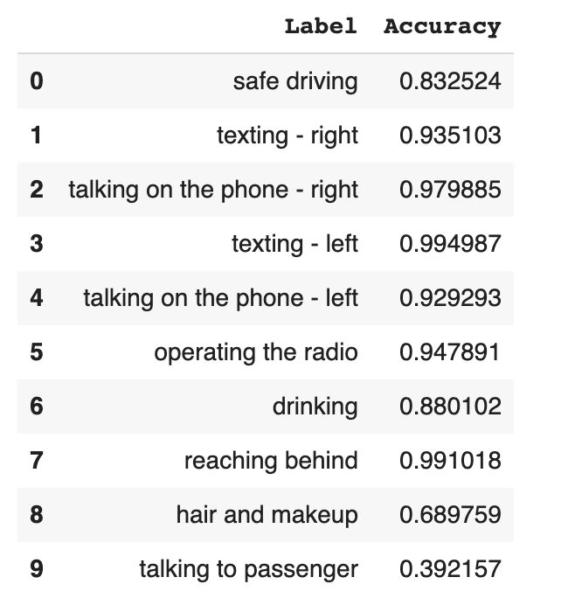
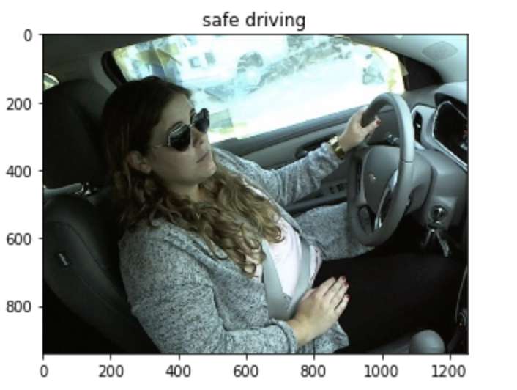
Evaluation: Accuracy on Different Labels
Misclassification Example

Slide 20
Conclusion
Pretrained Xception Model on Imagenet is the ideal model for State Farm Distracted Driver Detection Data based on the accuracy and runtime performance.
Although the size of our training data is small, data augmentation can help avoid the problem of overfitting.
P100 GPU is the best choice for our model based on the price and runtime.
Although overall performance of the model is good, the model cannot work well on some labels like ‘talking to passengers’. More research can be done on how to distinguish between two similar pictures with different labels.
Another improvement can be done is that maybe we can find an Xception Model pretrained on data similar to State Farm Distracted Driver Detection Data.

Slide 21
Thank you for listening!
https://github.com/jiegu6617/CSCI3033

